Slide 1
QUESTIONS

Slide 2
WORKSHEET EXAMPLE
A Simple Model of The Carwash System
Vehicles arrive into a carwash shop to get a simple wash and clean up.
The Carwash system consists of a single wash machine, which provides the actual service to the vehicles.
Arriving vehicles join a line to wait for service. The vehicle at the head of the line is the one that is next to be serviced by the carwash machine.
After the vehicle wash is completed, the vehicle leaves the system.

Slide 3
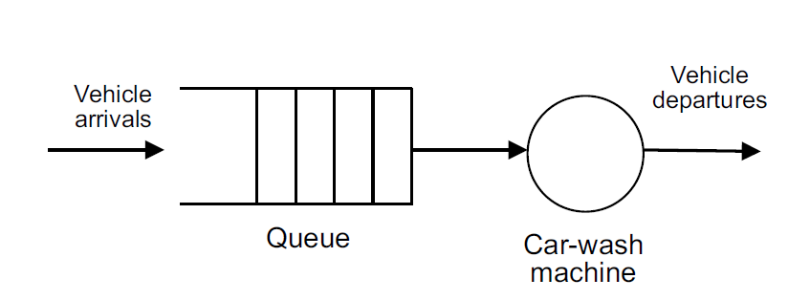
WORKSHEET EXAMPLE
The vehicles are considered the customers of the system, as they are the entities requesting service by the server (the wash machine).
Figure 2.2 shows a graphical view of the conceptual model of the Carwash system.

Slide 4
WORKSHEET EXAMPLE
The arrival of vehicles occurs randomly and the time between arrivals (the inter-arrival intervals) follow the behavior represented by an exponential probability distribution with mean value of 7.5 in minutes.
Max. Arrivals: Infinite. One car pass from the washing machines at one time.
The service of vehicles occurs randomly and follows the behavior represented by a normal probability distribution with mean value of 11.25 and std. dev. 1.25 in minutes.
The resource name is Wash machine. (1 Machine)
Looking for the results of 14 hours.

Slide 5
WORKSHEET EXAMPLE-2
Create Module: The entrance process is Initiate Mortgage Application. For the Entity Type, name our entities by typing Application. Inter-arrival times of jobs is exponentially distributed with a mean of 10 hour
Process Module: Process name is Review Application. To define a resource to perform this process, pull down the Action list and select Seize Delay Release in Process module.
Define a constant 16 hour processing delay Arriving entities will wait their turn for the resource to be available. When its turn comes, the entity will seize the resource, delay for the process time, and then release the resource to do other work.

Slide 6
WORKSHEET EXAMPLE-2
A list of resources will appear in the center of the dialog box.
If more than one resource is required for a process to be performed, add as many as are necessary in the Process dialog’s Resources list. An entity won’t commence its process delay until all listed resources are available.
In the Resource Name field of the Resource dialog box, type Mortgage Review Clerk. After the mortgage application has been reviewed, we determine whether to accept or return the application.
In Arena, whenever an entity selects among branches in the process logic, taking just one of the alternatives, a Decide module is used.
For the mortgage application process, we’ll use a simple probability to determine the outcome of the decision, with 88% of applications accepted as complete.

Slide 7
WORKSHEET EXAMPLE-2
When you use a 2-way Decide module, the entity that enters the module leaves via one of the two exit points. If you want to make copies of an entity to model parallel processes, use a Separate module.
For the Percent True field, type 88 to define the percent of entities that will be treated with a “True” decision (i.e., will depart through the exit point at the right of the Decide module).
There are two possible outcomes of the mortgage application process—applications can be accepted or returned—we’re using two Dispose modules that will count the number of applications under each outcome

Slide 8
WORKSHEET EXAMPLE-2
Double-click the first Dispose module (connected to the True condition branch of the Decide module) to open its property dialog box, and in the Name field, type Accepted.
Double-click the other Dispose module to open its property dialog box. In the Name field, type Returned.
Along with our flowchart, we also can define parameters associated with other elements of our model, such as resources, entities, queues, etc.
For the mortgage process, we’ll simply define the cost rate for the Mortgage Review Clerk so that our simulation results will report the cost associated with performing this process. The clerk’s costs are fixed at $12 per hour.
To provide these parameters to the Arena model, you’ll enter them in the Resources spreadsheet.

Slide 9
WORKSHEET EXAMPLE-2
We defined the Mortgage Review Clerk as the resource in the Review Application process, Arena has automatically added a resource with this name in the Resources spreadsheet.
Click in the Busy/Hour cell and define the cost rate when the clerk is busy by typing 12. Click in the Idle/Hour cell and assign the idle cost rate by typing 12
To make the model ready for simulation, we’ll specify general project information and the duration of the simulation run. Since we’re just testing our first-cut model, we’ll perform a short, 20-day run.

Slide 10
WORKSHEET EXAMPLE-2
In the Project Title field, type Mortgage Review Analysis; we’ll leave the Statistics Collection check boxes as the defaults, with Entities, Queues, Resources, and Processes checked and also check the costing box.

Slide 11
WORKSHEET EXAMPLE-3
Resource button on the Animate toolbar.
Resource Placement dialog box appears. Select the Mortgage Review Clerk from the drop-down list in the Identifier field so that this object animates the Mortgage Review Clerk.
Open the Workers picture library by clicking the Open button, then browsing to the Workers.plb file in the Arena application folder (e.g., C:\Program Files\Rockwell Software\Arena) and double-clicking on it.

Slide 12
WORKSHEET EXAMPLE-3
To change the idle picture:
Click the Idle button in the table on the left.
Select from the picture library table on the right the picture of the worker sitting down.
Click the Transfer button between the tables to use the worker picture for the Idle resource state.
To change the busy picture:
Click the Busy button in the table on the left.
Select from the picture library table on the right the picture of the worker reading a document.

Slide 13
WORKSHEET EXAMPLE-3
Click the Transfer button between the tables to use the selected picture when the Mortgage Review Clerk is busy.
Click OK to close the dialog box. (All other fields can be left with their default values.)
The cursor will appear as a cross hair. Move it to the model window and click to place the Mortgage Review Clerk resource animation picture.
If you’d like to have the clerk appear a bit larger, select the picture and use the resize handles to enlarge it.

Slide 14
WORKSHEET EXAMPLE-3
Plot the number of applications in-process
The Plot dialog box appears. We’ll plot a single expression, the work-in-process (WIP) at the Review Application process. To add a data series to plot, go to the Data Series tab page and then click the Add button.
In the properties grid for the data series (by default it will be named ‘Series1’) go to the Source Data\Expression property. This property defines the simulation expression to monitor and plot. Type in the expression ‘Review Application.WIP’

Slide 15
WORKSHEET EXAMPLE-3
Now go to the Axes tab page and select the Left (Y) Value axis. Change the scale related properties for that axis to be as listed below
Specify the value ‘5’ for the Scale\Major Increment property, so that major tick marks on the y-axis is displayed every 5 units.
Now select the horizontal Time (X) axis. Change the scale-related properties for that axis to be as listed below.
Specify the value ‘480’ for the Scale\Maximum property. This sets the horizontal time axis of the plot to be 480 hours of simulated time, matching our run length.
Specify the value ‘48’ for the Scale\Major Increment property, so that major tick marks on the x-axis are displayed every 48 hours (or 2 days).

Slide 16
WORKSHEET EXAMPLE-3
The cursor changes to a cross hair. Draw the plot in the model window by clicking to locate each of the two opposite corners (e.g., the top-left and bottom-right corners), placing the plot below the flowchart and to the right of the resource.
With the edits complete, you may want to save them by clicking Save or pressing Ctrl+S.

Slide 17
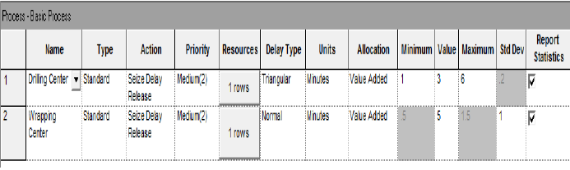
WORKSHEET EXAMPLE-3
Small Manufacturing Problem
Operations depends on parts are;
Part1 goes to Drilling Operation
Part2 goes to Wrapping Operation

Slide 18
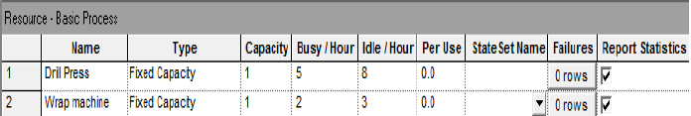
WORKSHEET EXAMPLE-3
Set Replication length as 16 hours

Slide 19
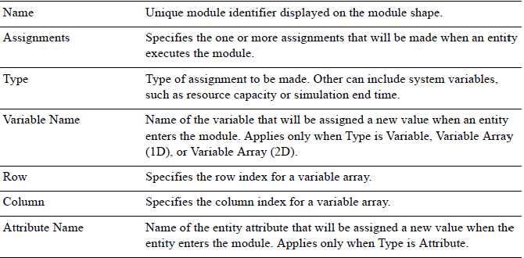
WORKSHEET EXAMPLE-4
ASSIGN MODULE

Slide 20
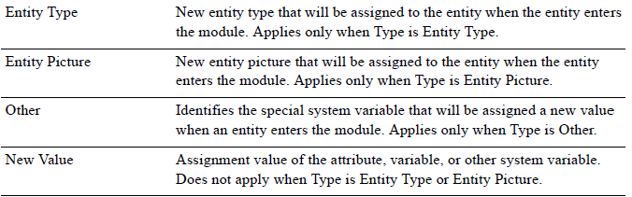
WORKSHEET EXAMPLE-4
ASSIGN MODULE

Slide 21
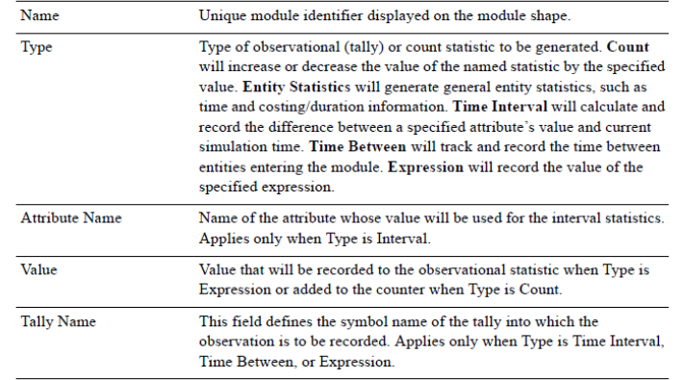
WORKSHEET EXAMPLE-4
RECORD MODULE

Slide 22
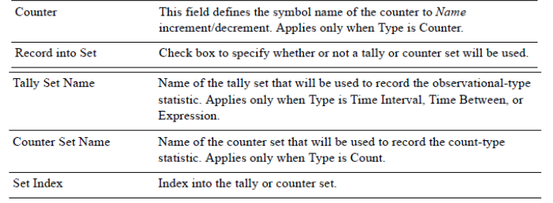
WORKSHEET EXAMPLE-4
RECORD MODULE

Slide 23
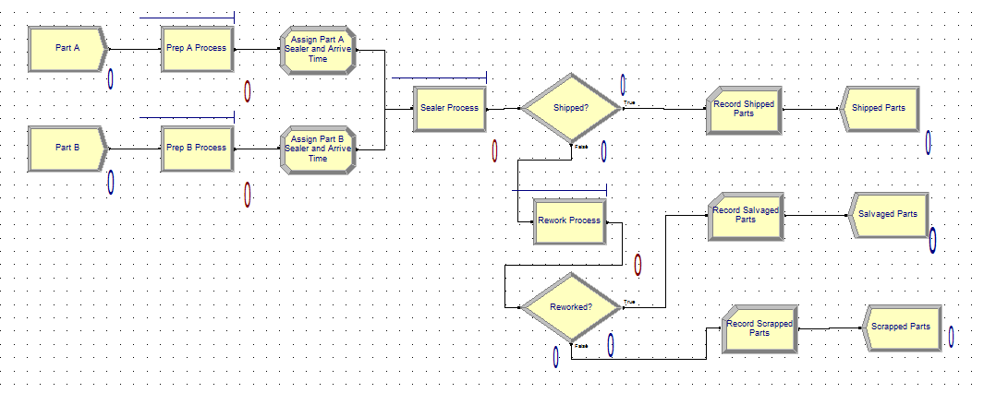
WORKSHEET EXAMPLE-4
INSPECTION CENTER PROBLEM

Slide 24
WORKSHEET EXAMPLE-4
INSPECTION CENTER PROBLEM
Produce two different sealed elect. units (A, B)
Arriving parts: cast metal cases machined to accept the electronic parts
Part A, Part B – separate prep areas
Both go to Sealer for assembly, testing – then to Shipping (out) if OK, or else to Rework
Rework – Salvage (and Shipped), or Scrap

Slide 25
WORKSHEET EXAMPLE-4
INSPECTION CENTER PROBLEM
Part A:
Interarrivals: expo (8) minutes
From arrival point, proceed immediately to Part A Prep area
Process = (machine + deburr + clean) ~ tria (1,4,8) min.
Go immediately to Sealer
Process = (assemble + test) ~ tria (1,3,4) min.
91% pass, go to Shipped; Else go to Rework
Rework: (re-process + testing) ~ expo (45)
80% pass, go to Salvage/Ship; Else go to Scrap

Slide 26
WORKSHEET EXAMPLE-4
INSPECTION CENTER PROBLEM
Part B:
Interarrivals: batches of 4, expo (25) min.
Upon arrival, batch separates into 4 individual parts
From arrival point, proceed immediately to Part B Prep area
Process = (machine + deburr +clean) ~ tria (3,5,10)
Go to Sealer
Process = (assemble + test) ~ weib (2.5, 5.3) min. , different from Part A, though at same station
91% pass, go to Shipped; Else go to Rework
Rework: (re-process + test) = expo (45) min.
80% pass, go to Salvage/Ship; Else go to Scrap

Slide 27
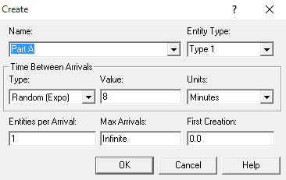
WORKSHEET EXAMPLE-4
INSPECTION CENTER PROBLEM

Slide 28
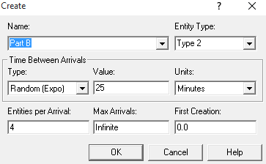
WORKSHEET EXAMPLE-4
INSPECTION CENTER PROBLEM

Slide 29
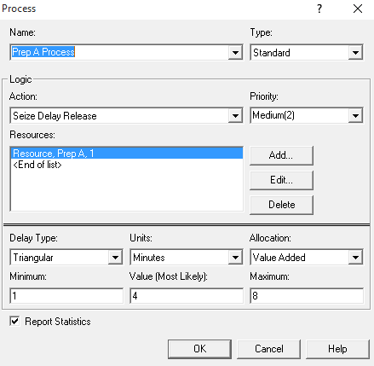
WORKSHEET EXAMPLE-4
INSPECTION CENTER PROBLEM

Slide 30

WORKSHEET EXAMPLE-4
INSPECTION CENTER PROBLEM

Slide 31
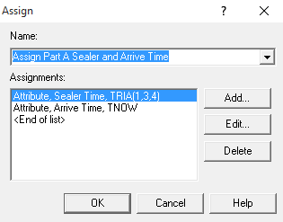
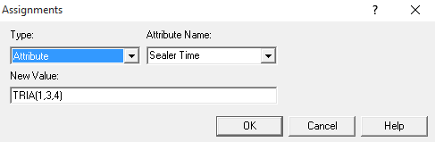
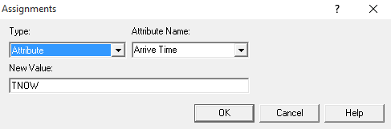
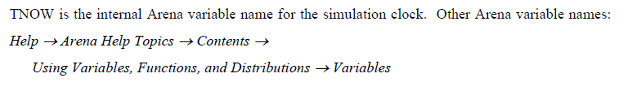
WORKSHEET EXAMPLE-4
INSPECTION CENTER PROBLEM

Slide 32
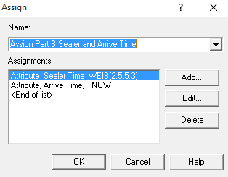

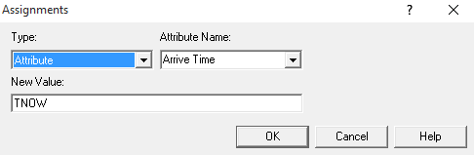
WORKSHEET EXAMPLE-4
INSPECTION CENTER PROBLEM

Slide 33
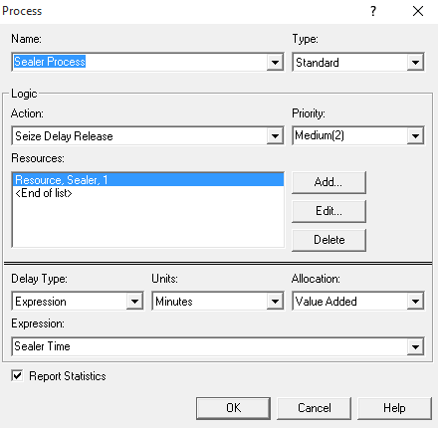
WORKSHEET EXAMPLE-4
INSPECTION CENTER PROBLEM

Slide 34
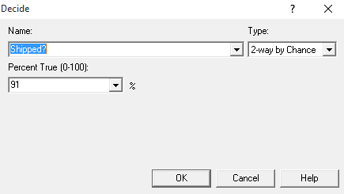
WORKSHEET EXAMPLE-4
INSPECTION CENTER PROBLEM

Slide 35
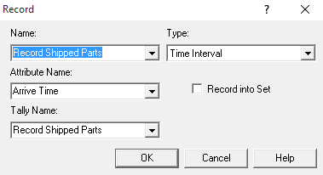
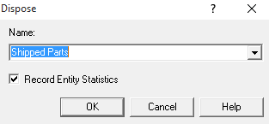
WORKSHEET EXAMPLE-4
INSPECTION CENTER PROBLEM

Slide 36

WORKSHEET EXAMPLE-4
INSPECTION CENTER PROBLEM

Slide 37
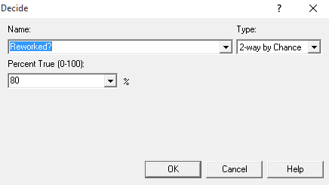
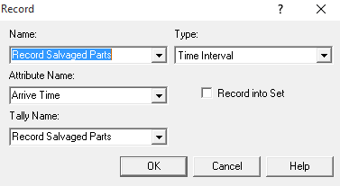
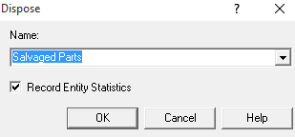
WORKSHEET EXAMPLE-4
INSPECTION CENTER PROBLEM

Slide 38
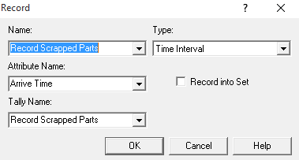
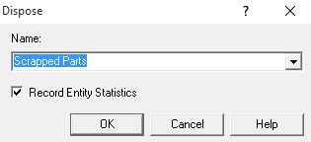
WORKSHEET EXAMPLE-4
INSPECTION CENTER PROBLEM

Slide 39
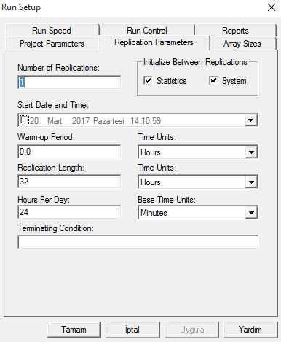
WORKSHEET EXAMPLE-4
INSPECTION CENTER PROBLEM

Slide 40
WORKSHEET EXAMPLE-5
Queue Module
Type –specifies queue disciplinear ranking rule
Shared –it this queue will be shared among several resources (more later …)
Report Statistics –check to get automatic collection and reporting of queue length, time in queue
Seize Module
Function: Used to allocate units of one or more resources to an entity.
Operation: When an entity enters this module, it waits in a queue until all specified resources are available simultaneously. The entity can seize units of a particular resource or units of a member of a resource set.

Slide 41
WORKSHEET EXAMPLE-5
Delay Module
Name—Unique module identifier. This name is displayed on the module shape.
Allocation—Type of category to which the entity’s incurred delay time and cost will be added.
Delay Time—Determines the value of the delay for the entity.
Units—Time units used for the delay time.
Release Module
The Release module is used by entities to release resources

Slide 42
WORKSHEET EXAMPLE-5
The emergency room of a small hospital operates around the clock. It is staffed by three receptionists at the reception office, and two doctors on the premises, assisted by two nurses.
However, one additional doctor is on call at all times; this doctor is summoned when the patient workload up-crosses some threshold, and is dismissed when the number of patients to be examined goes down to zero, possibly to be summoned again later.

Slide 43
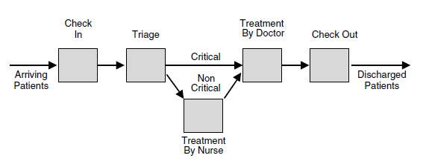
WORKSHEET EXAMPLE-5
Given Figure depicts a diagram of patient sojourn in the emergency room system, from arrival to discharge.

Slide 44
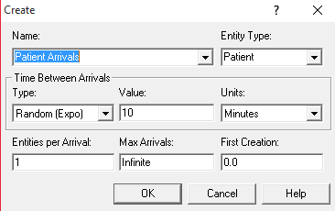
WORKSHEET EXAMPLE-5
Patients arrive at the emergency room according to a Poisson process with mean interarrival time of 10 minutes.

Slide 45
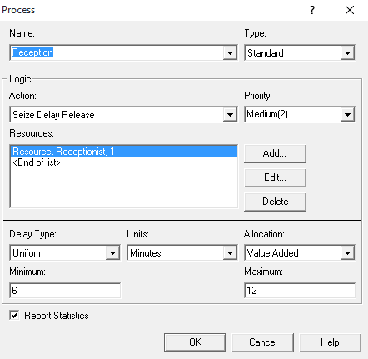
WORKSHEET EXAMPLE-5
An incoming patient is first checked into the emergency room by a receptionist at the reception office. Check-in time is uniform between 6 and 12 minutes.

Slide 46
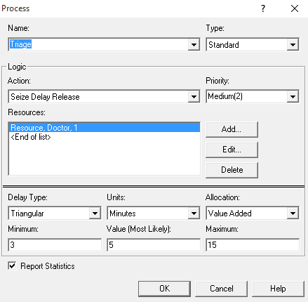
WORKSHEET EXAMPLE-5
Since critically ill patients get treatment priority over noncritical ones, each patient first undergoes triage in the sense that a doctor determines the criticality level of the incoming patient in FIFO order. Once check-in is completed, the patient entity proceeds to the Process module, called Triage, to undergo a triage checkout by a doctor.
The triage time distribution is triangular with a minimum of 3 minutes, a maximum of 15 minutes, and a most likely value of 5 minutes.

Slide 47
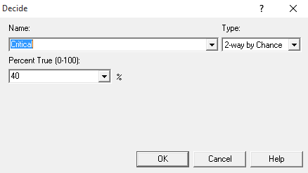
WORKSHEET EXAMPLE-5
After the triage delay is completed, the triage doctor is released and the patient entity proceeds to determine its level of criticality. To this end, it enters the Decide module, called Critical?
It has been observed that 40% of incoming patients arrive in critical condition, and such patients proceed directly to an adjacent treatment room, where they wait FIFO to be treated by a doctor.

Slide 48
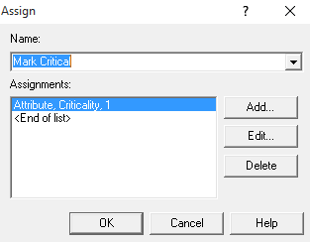
WORKSHEET EXAMPLE-5
The criticality level of patient entities is indicated in their Criticality attribute: a value of 1 codes for a critical patient, while a value of 0 codes for a noncritical patient. Accordingly, critical patient entities exiting module Critical? proceed to the Assign module, called Mark Critical, where their Criticality attribute is set to 1,

Slide 49
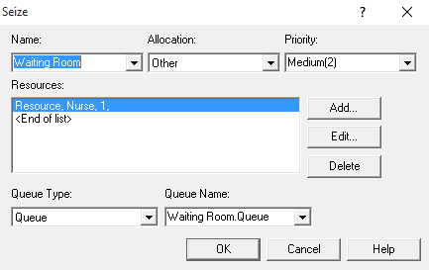
WORKSHEET EXAMPLE-5
In contrast, patients deemed noncritical first wait to be called by a nurse who walks them to a treatment room some distance away. In contrast, noncritical patient entities are automatically marked as such, since the default value of the Criticality attribute is 0 (recall that this is the Arena convention for all attributes). Such patient entities exiting module Critical? proceed to the Seize module (In Advanced Process ) called Waiting Room,

Slide 50
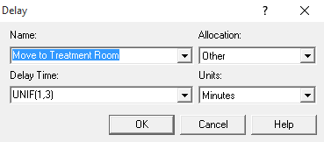
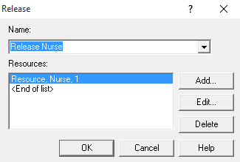
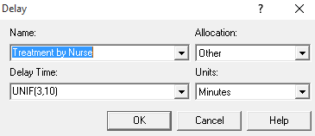
WORKSHEET EXAMPLE-5
Dialog boxes of the Delay modules Move to Treatment Room (left) and Treatment by Nurse (right).Once a nurse is seized, the patient entity passes through two Delay modules, move to Treatment Room models the uniformly distributed time between 1 and 3 minutes that it takes the nurse to walk a (noncritical) patient to a treatment room, while module Treatment by Nurse models the uniformly distributed time between 3 and 10 minutes that it takes the nurse to treat a patient.

Slide 51
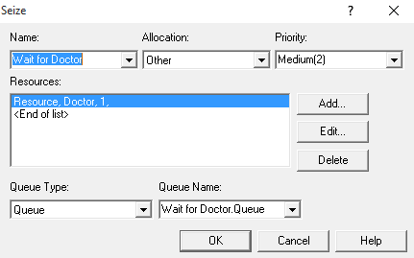
WORKSHEET EXAMPLE-5
At this point the paths of critical and noncritical patient entities converge, and all patient entities, both critical and noncritical, attempt to enter the Seize module, called Wait for Doctor. Note that an individual Seize module has the same functionality as the Seize option in a Process module, but with the added flexibility that the modeler can insert extra logic between the Seize and Delay functionalities (this is impossible in a Process module). The dialog box of the Wait for Doctor module

Slide 52
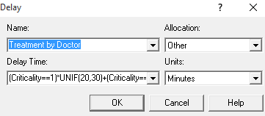
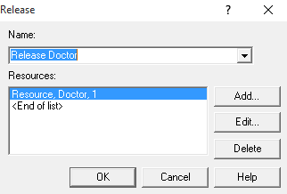
WORKSHEET EXAMPLE-5
(Criticality==1)*UNIF(20,30)+(Criticality==0)*UNIF(5,10)
Recall that the treatment duration of a patient depends on its level of criticality, namely, on its Criticality attribute
For critical patients, the duration is uniform between 20 and 30 minutes, while for noncritical ones it is uniform between 5 and 10 minutes only. This dependence is captured in the Delay Time field of Figure above by the expression
Once a doctor becomes available, the patient entity at the head of the line seizes that doctor and proceeds to the Delay module, called Treatment by Doctor The treatment time of critical patients is uniform between 20 and 30 minutes.

Slide 53
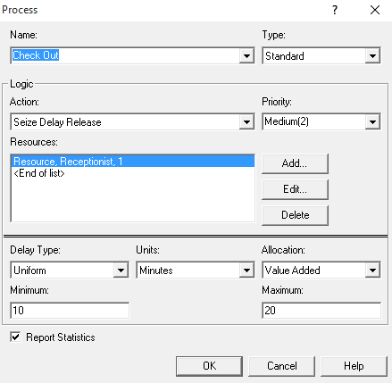
WORKSHEET EXAMPLE-5
The checkout procedure Process module requires a patient to seize a receptionist for a uniform time between 10 and 20 minutes, before releasing that receptionist.

Slide 54
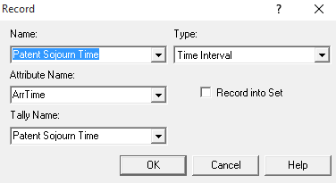

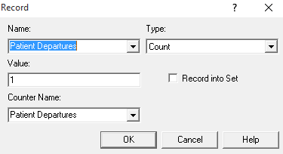
WORKSHEET EXAMPLE-5
Finally, patient entities enter two statistics-collecting Record modules, called Patient Sojourn Time and Patient Departures, respectively, whose dialog boxes are depicted in Figure below

Slide 55
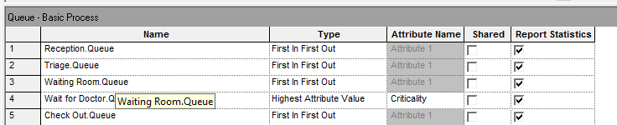
WORKSHEET EXAMPLE-5
Each row in the spreadsheet specifies a queue in the Arena model, while columns Type and Attribute Name specify jointly the queueing discipline. Observe that all rows, except row 4, specify the ordinary FIFO discipline, while row 4 implicitly specifies the FIFO within priority classes discipline. More specifically, patient entities in Wait for Doctor.Queue queue up FIFO, but their queueing priority is determined by their Criticality attribute (the higher the value of Criticality, the higher the priority).
24 HOUR REPLICATION LENGTH

Slide 56
WORKSHEET EXAMPLE-6
Resource Module
Format type may be; Calendar: defined using option in “Edit” menu, Duration: defined using “durations” button in spreadsheet view
A Time Pattern defines a series of values that change over time. For example, a worker might be on duty during a standard work shift from Monday through Friday.
The availability of the worker could be represented as a value of 1 when he’s on duty, 0 when he’s off duty. The time pattern that defines this availability schedule would list the changes from on duty to off duty over the week.
Time patterns are saved in an Arena model in the Schedule module with a Type set to Calendar. Their data are edited via the Time Pattern window, which is opened from the Edit > Calendar Schedules > Time Patterns… menu option.

Slide 57
WORKSHEET EXAMPLE-6
Batch & Separate Module
Separate module can be used to generate a duplicate of an entity.
If one chooses “Permanent” as Type, batched entities will never be split.
Separate module is also used for entities which combined in Batch process to separate each of them

Slide 58
WORKSHEET EXAMPLE-6
Calls arriving to a catalog 19 center where a number of representatives take the orders. The order must be filled by warehouse workers and the requested items must be loaded on a delivery truck.
Once the entire order is shipped, a copy of the ticket is sent to the billing department and sales department where the invoice and future mailing lists are generated, respectively.
Calls arrive and are routed to one of two operators. The operators take the customers' orders and enter them into the computer. The computer generates a sales ticket, and the call ends. The ticket proceeds to the warehouse.

Slide 59
WORKSHEET EXAMPLE-6
Once arriving at the warehouse, the orders are prepared and loaded into one of the delivery trucks.
Notice that the truck waits until 10 orders are ready before it departs.
The orders are delivered, and the driver returns and organizes his delivery slips to be confirmed. At this point, the delivery process ends.
Two different departments are notified of the completed deliveries, so that the customer may be billed, and the Catalog Center may compile a mailing list.

Slide 60
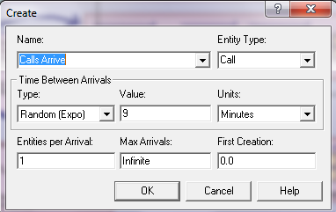
WORKSHEET EXAMPLE-6

Slide 61
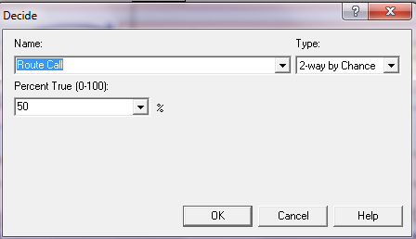
WORKSHEET EXAMPLE-6

Slide 62
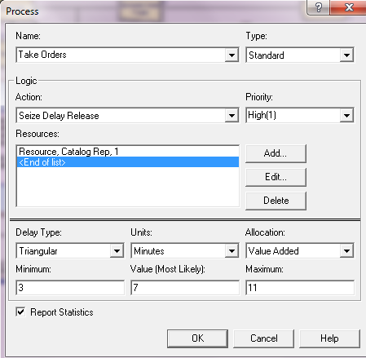
WORKSHEET EXAMPLE-6

Slide 63
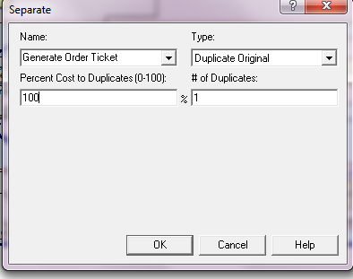
WORKSHEET EXAMPLE-6

Slide 64
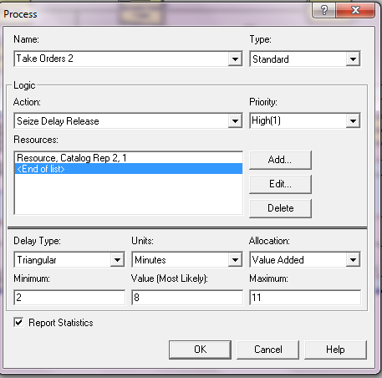
WORKSHEET EXAMPLE-6

Slide 65
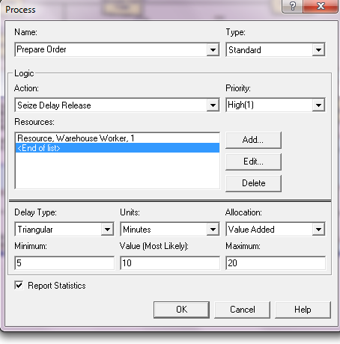

WORKSHEET EXAMPLE-6

Slide 66

WORKSHEET EXAMPLE-6

Slide 67

WORKSHEET EXAMPLE-6

Slide 68

WORKSHEET EXAMPLE-6

Slide 69


WORKSHEET EXAMPLE-6

Slide 70

WORKSHEET EXAMPLE-6

Slide 71

WORKSHEET EXAMPLE-6

Slide 72


WORKSHEET EXAMPLE-6

Slide 73


WORKSHEET EXAMPLE-6

Slide 74

WORKSHEET EXAMPLE-6

Slide 75
WORKSHEET EXAMPLE-7
This example concerns a transportation system consisting of a toll plaza on the New Jersey Turnpike, and aims to study the queuing delays resulting from toll collection. The system under study is depicted in Figure.
The toll plaza consists of two exact change (EC) lanes, two cash receipt (CR) lanes, and one easy pass (EZP) lane.

Slide 76
WORKSHEET EXAMPLE-7
Arriving vehicles are classified into three groups as follows:
1. Fifty percent of all arriving cars go to EC lanes, and their normal service time distribution is Norm(4.81, 1.01). Recall that only the non-negative values sampled from this distribution are used by Arena
2. Thirty percent of all arriving cars go to CR lanes, and their service time distribution is 5 + Logn(4.67, 2.26).
3. Twenty percent of all arriving cars go to EZP lanes, and their service time distribution is 1.18 + 4.29 * Beta(2.27, 3.02).

Slide 77

WORKSHEET EXAMPLE-7
To simplify matters, we assume that an incoming car always joins the shortest queue in its category (EC, CR, or EZP). We further assume that no jockeying between queues takes place. That is, once a car joins a queue in front of a tollbooth, it never switches to another queue.

Slide 78
WORKSHEET EXAMPLE-7
Traffic congestion is distinctly nonstationary, varying widely by time of day. As expected, traffic is heavier during the morning rush hour (6 A.M.–9 A.M.) and the evening rush hour (4 P.M.–7 P.M.), and tapers off during off-peak hours. Table 1 summarizes vehicle interarrival time distributions over each 24-hour period.
The number of operating cash receipt booths varies over time. Since such booths must be manned, and therefore are expensive to operate, one of them is closed during the off-peak hours. Only during morning and evening rush hours do all cash receipt booths remain open.

Slide 79

WORKSHEET EXAMPLE-7
Of course, additional issues may be specific to particular toll plazas under study, but in our case we wish to address the last issue in the list, using the performance metrics of average time to pass through the system and booth utilization. An Arena model for the toll plaza system presented here is depicted in Figure.

Slide 80

WORKSHEET EXAMPLE-7

Slide 81
WORKSHEET EXAMPLE-7
Car arrivals are generated in the Create module, called Cars Arriving, whose dialog box is displayed in Figure 2. Here, the Time Between Arrivals section specifies time-dependent sampling distributions for car interarrival times via the expression Int_Times(k). The variable Int_Times is a vector of sampling expressions, whose specification is displayed in Figure 3, and k is a variable representing an index between 1 and 5 for this vector.
Note that k and Int_Times correspond to entries in Table 1. In order to access the requisite distribution, the variable k is set to the appropriate row index by each arriving car entity depending on the time of day of its arrival.

Slide 82



WORKSHEET EXAMPLE-7
This assignment takes place immediately following a car creation, when the car entity enters the Assign module, called Assign Type and Modify Congestion Period, whose dialog box is displayed in Figure 4. The assignment of k is made in the third line of the Assignments section, which partially displays the expression (the conditions in parentheses are in seconds and an asterisk denotes multiplication):

Slide 83





WORKSHEET EXAMPLE-7

Slide 84
WORKSHEET EXAMPLE-7
Note that the variable t is set to the simulation clock variable Tnow in the second row of the Assignments section. Consequently, precisely one predicate (condition) is true (evaluates to 1) at any given time Tnow, and all others are false (evaluate to 0), thereby yielding the requisite row index.
In addition, the first line of the Assignments section samples each car’s type number (1 = exact change, 2 =cash receipt, 3= EZ pass) with the requisite probability (via the Arena DISC distribution), and assigns it to the car entity’s Type attribute. The fourth line saves the car entity’s arrival time, Tnow, in its ArrTime attribute (for future use in computing its system time).

Slide 85


WORKSHEET EXAMPLE-7
Once the assignments are made, the car entity proceeds to the Decide module, called Which Type, whose dialog box is displayed in Figure. This module dispatches a car entity to an appropriate tollbooth, in accordance with the car’s Type attribute.

Slide 86


WORKSHEET EXAMPLE-7
The notion of a location is implemented via the Station module (from the Advanced Transfer template panel), which may represent a single station (location) or a set of stations (multiple locations), each modeling a physical or a logical location in the model.
In our case, the single EZP tollbooth is modeled by a single Station module, and the multiple EC and CR tollbooths are modeled as sets of Station modules, since the logic for each tollbooth type is analogous.

Slide 87


WORKSHEET EXAMPLE-7
Figures the dialog box of the Station module set representing EC tollbooths. To this end, the option Set is selected in the Station Type field (as opposed to the option Station, which defines a single Station module).

Slide 88
WORKSHEET EXAMPLE-7
The name of this Station module set is specified in the Set Name field. The Save Attribute field is used to specify the attribute name in which to store the station ID when an entity enters a particular member of the Station module set. This ID is just the rank (position) of the requisite Station name in the list of the Station Set Members field.
In our case, the Station module ID is assigned elsewhere to attribute Current_Booth of the incoming car entity. Saving that ID can be useful, since it can be used to index the associated resource, queue, and so on.
While tollbooths are modeled by Station modules, dispatching cars to tollbooths by type is implemented in a PickStation module (from the Advanced Transfer template panel), which allows an entity to select a particular Station module among a set of such modules, based on some prescribed condition. Accordingly, module Which Type dispatches car entities of type 1 (EC), type 2 (CR), and type 3 (EZP), respectively, to the PickStation modules Exact Change Cars, Cash Receipt Cars, and Station module Easy Pass Station, based on their Type attribute.

Slide 89

WORKSHEET EXAMPLE-7
Each car entity that enters its PickStation module selects a station from a set of stations (tollbooths), as illustrated in the dialog box of Figure 7 for EC cars (type 1). Here, the list of Station modules and queues to choose from is constructed by the modeler in the Stations section with the aid of the three buttons to its right. Each entry specifies a Station module. (recall that EC_1 and EC_2 label the two EC tollbooths) and an associated queue (ECSQ_1 and ECSQ_2 label the queues in the EC tollbooths).

Slide 90



WORKSHEET EXAMPLE-7

Slide 91





WORKSHEET EXAMPLE-7

Slide 92
WORKSHEET EXAMPLE-7
The creation of queue sets and their members is analogous, except that the Advanced Set module (from the Advanced Process template panel) is used instead of the Set module.
Figure 12 displays the spreadsheet views of the Advanced Set modüle (bottom) and the members of the queue set EC Queues (top), where the attribute Current_Booth holds the ID of the corresponding tollbooth queue.
Once a car entity succeeds in seizing its respective server resource (tollbooth), it enters a Delay module in its path for the duration of the toll payment activity.

Slide 93

WORKSHEET EXAMPLE-7
Finally, recall that MR(R) and NQ(Q) are the Arena functions returning the current number of resource units in resource R and the current number of entities in queue Q, respectively, and suppose that queue CRSQ_2 can accommodate less than 1000 cars (otherwise, replace 1000 by a sufficiently large number, which surely exists). Now, to ensure that the expressions in the Stations section are properly defined, consider the following two cases pertaining to the expression for CR_1.

Slide 94


WORKSHEET EXAMPLE-7
Finally, recall that MR(R) and NQ(Q) are the Arena functions returning the current number of resource units in resource R and the current number of entities in queue Q, respectively, and suppose that queue CRSQ_2 can accommodate less than 1000 cars
(otherwise, replace 1000 by a sufficiently large number, which surely exists). Now, to ensure that the expressions in the Stations section are properly defined, consider the following two cases pertaining to the expression for CR_1.

Slide 95


WORKSHEET EXAMPLE-7
To specify these constructs, the requisite sets are created first. More specifically, to create a set of queues, the Set option is selected in the Queue Type field, and its name is entered in the Set Name field. Next, the Add button is used to create the requisite resource set, by popping up the Resources dialog box
Here, the Set option is first selected in the Type field, and its name is entered in the Set Name field. Next, the Specific Member option is selected in the Selection Rule field, and the attribute name Current_Booth is entered in the Set Index field (recall that the latter will hold the appropriate ID of the resource to be seized).

Slide 96



WORKSHEET EXAMPLE-7

Slide 97



WORKSHEET EXAMPLE-7

Slide 98
WORKSHEET EXAMPLE-7

Slide 99


WORKSHEET EXAMPLE-7
Here, the Type field is set to the Time Interval option, which records the elapsed time from the value stored in the car’s attribute specified in the Attribute Name field. Since that attribute (ArrTime) was previously arranged to store the car’s arrival time at the toll plaza, the requisite flow times are indeed collected.
Note that the check box Record into Set is marked in Figure 16. Note further that a name is specified in the Tally Set Name field (Flow Times), and that the option selected in the Set Index field is the car entity’s Type attribute. These data arrange to record flow times separately by car type—EC, CR, and EZP. Arena uses a set of three tally statistics to manage system flow-time collection by car type.

Slide 100
WORKSHEET EXAMPLE-8
Consider a production/inventory system in which the production process (e.g., packaging) is comprised of three stages;
1. filling each container unit (e.g., bottles)
2. sealing each unit
3. placing labels on each unit
A raw-material storage feeds the production process, and finished units are stored in a warehouse. Customers arrive at the warehouse with product requests (demands), and if a request cannot be fully satisfied by on-hand inventory, the unsatisfied portion represents lost business.
The production process component operates as follows: there is always sufficient raw material in storage, so the production process never starves. Product processing is carried out in lots of 5 units, and finished lots are placed in the warehouse

Slide 101
WORKSHEET EXAMPLE-8
Lot processing time is uniformly distributed between 10 and 20 minutes. The production process experiences random failures, which may occur at any point in time
1. Times between failures are exponentially distributed with a mean of 200 minutes
2. Repair times are normally distributed, with a mean of 70 minutes and a standard deviation of 45 minutes
The warehouse component operates as follows:
Warehouse operations implement the inventory control policy, where;
1. The warehouse has a capacity (target level) of units
2. The production process stops when the inventory in the warehouse reaches the target level
3. From this point and on, the production process remains inactive until the inventory level drops to or below the reorder point of units
4. At this point the production process is restarted until the warehouse inventory level reaches the target level

Slide 102
WORKSHEET EXAMPLE-8
The inter-arrival times between successive customers are uniformly distributed between 1 to 3 hours, and individual demand sizes are distributed uniformly between 50 and 100 units
On customer arrival, the inventory is immediately checked and if there is sufficient stock on hand, that demand is promptly satisfied, and otherwise, the unsatisfied portion of the demand is lost. The Arena model of the production/inventory system is composed of two segments: inventory management and demand management
In the Arena model logic of the inventory management segment: the packaging process takes a unit of raw material from its queue and processes it as a batch of 5. The finished lot is added to the warehouse inventory (variable Inventory)
If Inventory reaches or up-crosses the target level (variable Target Stock), then production stops until the reorder point (variable Reorder Point) is reached or down-crossed again. Processing of a new batch starts immediately when the reorder point is down-crossed

Slide 103
WORKSHEET EXAMPLE-8
In the Arena model logic of the demand management segment: arrivals of customers and their demands at the warehouse are generated, the variable Inventory is adjusted upon customer arrival, the value of Inventory is monitored for triggering resumption of suspended production when the reorder point is down-crossed, track is kept of lost demand
The Arena model logic implementation of the inventory management segment makes use of the following modules:
1. The Create module, called Raw Material, generates product units for the packaging (batching) operation
2. The packaging operation is modeled using a sequence of Seize, Delay and Release modules
3. The actual processing (packaging in our case) takes place at the Delay module, called Packaging Process, where the packaging time of a batch is specified as minutes Unif( )

Slide 104

WORKSHEET EXAMPLE-8

Slide 105


WORKSHEET EXAMPLE-8

Slide 106

WORKSHEET EXAMPLE-8
The Hold module performs a gating function on entities
• the dialog box below illustrates the use of a Hold module for checking the production state
The state of production (0 = off or 1 = on) is maintained in a variable, called Production, initially set to 0
• the Hold module scan for the truth or falsehood of a logical condition, (Production = = 1), and holds the entity in the module until the condition becomes true
• once the condition becomes true, the entity proceeds to the next module, and otherwise, it waits on in a Queue, called Shall We Produce?.Queue

Slide 107



WORKSHEET EXAMPLE-8
The inventory level at the warehouse is maintained in a variable, called Inventory, initially set to 250
• each product entity (batch of 5 units) that enters the Assign module, called Update Inventory, increases the warehouse inventory level by a batch of 5 finished jobs by adding the Batch Size to the variable Inventory
• that entity then proceeds from the Hold module, called Shall We Produce?, to the Decide module, called Check Target

Slide 108



WORKSHEET EXAMPLE-8
A spreadsheet view of Resource modules (from the Basic Process template panel) is used to list all resources and their attributes
• One of the attribute fields is Failures, which specifies resource failures in a dialog box
• the dialog box below shows the resource Packaging Process with its Failures field details

Slide 109


WORKSHEET EXAMPLE-8
The Decide module is used by entities to make branching decisions, based on chance or the truth/falsity of prescribed conditions the dialog box below makes a two-way probabilistic branching decision by checking the inventory target level
The entity tests there whether or not the inventory target level has been up-crossed as follows:
• if the inventory target level has been up-crossed, then the entity moves on to the Assign module, called Stop Production, and sets Production = 0 to signal that production is suspended
• otherwise, the entity does nothing

Slide 110


WORKSHEET EXAMPLE-8
The Create module generates a stream of arrivals of Arena entities(jobs, people, demands, etc.)the dialog box below models the arrival of customer demands . The arrival pattern of customers is specified to be random with inter-arrival time distribution Unif(1,3)
On arrival, the customer entity first enters the Assign module, called Customer Demand, where its Demand attribute is assigned a random value from the distribution Unif(50,100 )

Slide 111

WORKSHEET EXAMPLE-8
The customer then proceeds to the Decide module, called Check Inventory, to test whether the warehouse has sufficient inventory on hand to satisfy its demand
•If the variable Inventory has an equal or larger value than attribute Demand, then the customer takes the True exit to the Assign module,
called Take Away From Inventory, where its inventory is decreased the by the demand amount
• it next proceeds to the Decide module, named Restart Production, to test whether the Reorder Level variable has just been down crossed
• if it was down crossed, the customer proceeds to the Assign module, called Production Start, to set Production = 1, which would promptly release the product entity currently detained in the Hold module Shall We Produce?, effectively resuming the production process
• either way, the Customer entity proceeds to be disposed of at the Dispose module, called Dispose1

Slide 112



WORKSHEET EXAMPLE-8

Slide 113


WORKSHEET EXAMPLE-8
Replication Length: 24 hour

Slide 114


WORKSHEET EXAMPLE-8

Slide 115
WORKSHEET EXAMPLE-8
a Time-Persistent statistic, called Stock On Hand, for the Inventory variable
• a Time-Persistent statistic, called Production On, for the condition Production = 1
• a Frequency statistic, called Process States, which estimates the state probabilities of the packaging process, namely, the probabilities that the packaging process is busy or down
• The statistical outputs for Inventory include the average value
• 95% confidence interval
• minimal and maximal values
•The statistical output for state Production = 1 is the percentage of time this expression is true, that is, the probability that the packaging process is in production

Slide 116

WORKSHEET EXAMPLE-9
Cells 1, 2, and 4: single machine each
Cell 3: two machines — newer one 20% faster
Need: way to model non-identical resource units
Circular layout of cells
Parts enter at left, exit at right, travel only clockwise, all transfer times = 2 min.

Slide 117




WORKSHEET EXAMPLE-9

Slide 118



WORKSHEET EXAMPLE-9
Speed factor at Cell 3: 2 x 1 vector Factor
0.8 for index 1 (new machine), 1.0 for index 2 (old)

Slide 119



WORKSHEET EXAMPLE-9

Slide 120
WORKSHEET EXAMPLE-9
There are usually several different ways to represent a model in software
Often driven by data requirements, availability
Decide on and write down ahead of time how things will be represented; here:
– Sequences (in a Set) to control part flow
– Assign entities in Sequences for process times except for Cell 1
– Use Expression vector for process times at Cell 1
– Use Variables for transfer times, speed factor at Cell 3
Define station paths for different part types
Name the sequences
Part 1 Process Plan, Part 2 Process Plan, etc.
Can define actions at each station as part of the definition of the sequences
Define Process Time attribute (except at Cell 1)
Group the sequences into a Set (later)
Assign a sequence, indexed by set, to each arriving part once its type is generated
Don’t forget to define “exit” for each sequence

Slide 121
WORKSHEET EXAMPLE-9
Identify model and define Length of Replication, as in earlier models
Also, draw the three entity Pictures and associate with names of members of Pictures set
– Double-click on “generic” entity picture above module handle
– Add new or edit existing pictures in list
Copy current last entry to add to bottom of list
Draw: shapes, size; colors for fill, line, text, etc.
Close drawing window to accept
– Names (Values) must already be assigned in Sets
– Need: way to change routing depending on part type — process plans

Slide 122
WORKSHEET EXAMPLE-9
Create Module
Three separate part types
– Interarrivals (all types merged) ~ expo(13) minutes
– 26% type 1, 48% type 2, 26% type 3
Assign Module
Attributes:
Part Index DISC( 0.26,1 , 0.74,2 , 1.0,3 )
Entity.Sequence Part Sequences ( Part Index )
Station Module
Station name: Order Release

Slide 123
WORKSHEET EXAMPLE-9
Time Between: EXPO(13)
– Mark Time Attribute: Enter Time
– Leave Data
Route: select (this is the default anyway)
Seq: select
Route Time: Transfer Time
Station: Cell 1 (or Cell 2 or Cell 4 )
– Process Time:
If Cell 1: Cell 1 Times(Part Index)
– Global Expression defined in Expressions module
If Cell 2 or 4: Process Time
– Entity Attribute defined as part of Sequences
– Leave Data:
Route: select
Seq: select
Route Time: Transfer Time
– Global Variable defined in Variables module

Slide 124
WORKSHEET EXAMPLE-9
Station Module
Station name: Cell 1
Process Module
Resource: Cell 1 Machine
Name: Cell 1 Process
P. Time: Process Time
Route Module
Route Time: Transfer Time
Destination Type: By Sequence

Slide 125
WORKSHEET EXAMPLE-9
Station Module
Station name: Cell 2
Process Module
Resource: Cell 2 Machine
Name: Cell 2 Process
P. Time: Process Time
Route Module
Route Time: Transfer Time
Destination Type: By Sequence

Slide 126
WORKSHEET EXAMPLE-9
Station Module
Station name: Cell 3
Process Module
Set Name: Cell 3 Machines
Selection Rule: Cyclical
Save Attribute: Machine Index
Name: Cell 3 Process
P. Time: Process Time
Route Module
Route Time: Transfer Time
Destination Type: By Sequence

Slide 127
WORKSHEET EXAMPLE-9
Station Module
Station name: Cell 4
Process Module
Resource: Cell 4 Machine
Name: Cell 4 Process
P. Time: Process Time
Route Module
Route Time: Transfer Time
Destination Type: By Sequence

Slide 128



WORKSHEET EXAMPLE-9
Station Module
Station name: Exit System Station

